Slide 1
Bringing the pieces together
Speakers:
Rajiv Rajani - CTO - iSHARE Foundation
Dr. Dennis Wendland - Technical Lead & Architect - FIWARE Foundation

Slide 2
Bringing the pieces together
About:
This session will explain how everything comes together under i4Trust using a reference example
This session will:
Recap roles in i4Trust and how they can function together
Introduce to a reference example for i4Trust
Explain the architecture of the reference example
Make a demo of the reference example
Goals:
After this session you will be able to showcase the provided reference example for i4Trust
After this session you will be able to help SMEs in designing their use cases
Target Audience:
All (LEBDS, Ambassadors)

Slide 3








Recap: A data space is an decentralized data ecosystem built by the parties with common purpose
Further, it can be defined as a decentralized data ecosystem built around commonly agreed building blocks enabling an effective and trusted sharing of data among participants.
Data consumers, data providers and identity and authorisation service providers form an ecosystem with a governance structure in place to create a basic data space
Additionally, service providers like Marketplaces, Brokers, Billing and Clearing etc. can be part of data space to support variety of use cases
In i4Trust iSHARE and FIWARE bring the necessary components along with basic governance structure to create the i4Trust data space
Data Space
Data Consumers
Data Providers
Identity and Authorisation service providers
Data Space Governance
Marketplace and other service providers

Slide 4

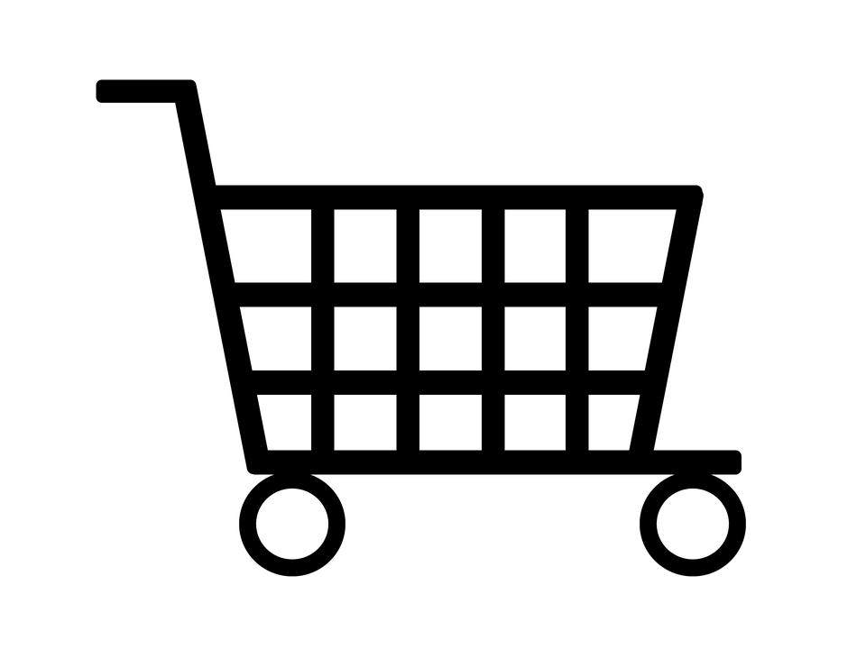
Recap: Roles in a Data Space
Data Space
Trust Provider
Data Consumer
Data Provider
Data Owner
Identity Provider
Marketplace
Authorisations Provider
Notes:
Though these roles are mentioned separately, it does not restrict an organization from playing multiple roles.
Trust Provider: Every data space needs a trust provider who acts as register of participants of the data space and keeps their status up to date. In a large data space there can be more than one trust provider. In i4Trust this role will be fulfilled by iSHARE satellite.
Data sharing roles:
Data Consumer: A party or person who consumes data provided by the data provider. The data consumer has to agree to use the data as defined by the data license under which it received the authorization to access that data.
Data Provider: A organization that hosts service to provide data on behalf of data owners. Data provider has responsibility to verify who the data consumers are and provide only data that they are authorized to have access to.
Data Owner: A party or person who owns the data in the context of the process at a given time. Do note that data owner does not have necessarily have to be data creator.
Service Provider roles:
Identity Provider: A service provider that provides authentic human identities of data consumers or data providers so that either of them can be sure that they are dealing with the right party. Identity provider also provides the level of assurance of the identity.
Authorisations Provider: A service provider that provides services to data owners to register authorisations to data consumers/data providers. Alternatively, a data owner could chose to play the role themself as long as they host the authorisation provider APIs
Marketplace: A service provider which allows data owner to publish data available for data consumers to be purchased or publish services data consumers can purchase. Marketplace enables discovery of data for data consumers.

Slide 5



Recap: Roles in i4Trust complies to iSHARE and FIWARE
Data Space
Trust Provider
iSHARE Satellite
Data Consumer
Data Provider
Context Broker
Data Owner
Identity Provider
(Keyrock)
Marketplace
FIWARE Marketplace
Authorisations Provider
(Keyrock)
Notes:
As you can see from picture that for each role iSHARE enables those roles to interact with each other using the trust framework and FIWARE provides the technology and solution to effectively share data in a data space in i4Trust.
The trust provider role is as role defined by iSHARE satellite which acts as participant register
The data consumer is the organization or person consuming service/data via a service provided by data provider while identifying itself using standards defined in iSHARE which allows them to connect to any data provider who is also iSHARE enabled.
The data provider can provide data to data consumer as authorized by data owner and FIWARE context broker technology provides intelligence and context information needed to make data meaningful.
The data owner can register authorizations over its data and specify the conditions under which data is shared which data consumer must abide by. When shared using the iSHARE trust framework the data consumer is legally obliged to use data in accordance with the conditions specified.
The Marketplace provided by FIWARE technology allows data providers and data owners to list data and/or services to offer which data consumers can buy/subscribe to. On the other hand data consumers can find offerings of relevant data from multiple data providers/owners. Besides, marketplace can act as clearing house and broker when required between the parties exchanging data so that data sharing transactions can be logged at 3rd party for auditing and billing purposes.
The identity provider role deals with the human identities with varying level of assurances as defined in eIDAS framework to support various use cases. Depending on the criticality of the data, appropriate level of assurance for identity can be provisioned.
The authorizations provider is a role which can be played by any organization as defined in iSHARE. The role only defines the interface for asking about authorizations and how the response should look like. The authorizations can be determined by using a policy database and/or transactional data from backend systems and/or existing authorizations from LDAP/AD or a combination thereof. Keyrock powered by FIWARE will provide a policy database to define policies for authorizations which can be combined with other sources to determine authorization during runtime.

Slide 6
Use case
A packet delivery company wishes to offer its various services electronically for enhanced customer experience
It wants to automate the process of acquiring of its services via its customers
eCommerce site would like to choose delivery services offerings that fits it requirements and can enhance the shopping experience of their customers
It wants to offer its paying loyal customers with flexible delivery services
It also wants to enable its employees to better manage customers delivery preferences
Another eCommerce site is just looking to provide standard delivery services in a cost effective manner
It wants to offer delivery services at a bargain price that matches it business

Slide 7
Meet the Participants

Slide 8

Packet Delivery Co. - Packet Delivery company is a parcel service provider delivering packets all over the world
i4Trust Role: Data Provider/Data Owner
Offers its services electronically to different retailers, in order to allow them to issue packet delivery orders, trace location of orders and allow their customers to perform requests for adjustments on address, date and time of planned delivery when their clients are entitled to
It offers two kind of Packet Delivery services:
Standard Packet Delivery
Gold Packet Delivery
Identifier: EU.EORI.NLPACKETDEL
Components:
Context Broker
Identity Provider
PEP Proxy/PDP
Authorisation Registry (AR) + Activation Service (AS)
Portal application
Orders map to Digital Twin entities
Gold users can change Destinee, Delivery Address, Planned Day of Arrival, Planned Time of Arrival

Slide 9
Packet Delivery Co - offerings
Standard Packet Delivery
Standard Packet Delivery
The customer simply is given the opportunity to specify the issuer (sender) of the packet, the address, date and time at which the packet to be delivered is ready for collection, and the name and address of the destinee to whom the package has to be delivered.
When Packet Delivery Company receives a packet delivery order from a given customer, it returns the target date at which the packet is planned to be delivered.
Gold Packet Delivery
Service for which the customer enjoys all the benefits of the “Standard Packet Delivery” but also is allowed to adjust the concrete address of delivery, date of delivery within an offered period, as well as concrete time of delivery within the selected date of delivery, provided such adjustments are feasible (e.g., are requested enough time in advance and do not imply additional costs).
Standard Packet Delivery
Standard Packet Delivery
Under defined terms and conditions (e.g., there are no problems with customs, addresses are valid, etc), it commits to deliver the packet in 48 hours within the same country and 5-6 days if it requires international shipping.
However, customers are not allowed to adjust the concrete date of delivery (e.g., delaying it to a more suitable date) nor fine-tune the concrete time of delivery within the selected date of delivery.

Slide 10

Happy Pets Inc. - Online e-commerce for pet products
i4Trust Role: Data Consumer/Data Owner
Identifier: EU.EORI.NLHAPPYPETS
Components:
Identity Provider(s)
Authorisation Registry (AR)
Shop system application
Acquires Gold offering from Packet Delivery Co so it can offer Standard delivery service to it Regular customers and Gold delivery service to its Prime customers
Prime customers are allowed to adjust
the concrete address of delivery
date of delivery within an offered period
concrete time of delivery within the selected date of delivery,
provided such adjustments are feasible (e.g., are requested enough time in advance and do not imply additional costs)

Slide 11

No Cheaper Inc. - Online e-commerce for bargain products
i4Trust Role: Data Consumer/Data Owner
Identifier: EU.EORI.NLNOCHEAPER
Components:
Identity Provider(s)
Authorisation Registry (AR)
Shop system application
Acquires standard offering so it can offer only standard delivery service to its customers

Slide 12

iSHARE Satellite - ensures trust among different organisations
i4Trust Role: Trust Provider
Identifier: EU.EORI.NL000000000 (iSHARE Satellite test)
Onboard and maintain list of participants and its statues
Provide APIs for participants to get detailed information along with statues of other participants with whom they want to interact or are interacting
Enables multilateral trust when participants signup
Plays the facilitator role for common agreements like, but not limited to business agreements, operational agreements, etc.
Is federated part of the governing body of data spaces that interoperate
iSHARE Satellite

Slide 13

i4Trust Marketplace. - Marketplace where data providers and owner publishes their offerings
i4Trust Role: Marketplace
Identifier: EU.EORI.NLMARKETPLA
Components:
Business API Ecosystem
Packet Delivery Co. publishes its offering on i4Trust Marketplace for acquisition by organisations (e.g. retailers/shops)
Basic: Organisations can offer Standard service level to its customers
Premium: Organisations can offer Gold service level to its customers
Supports various business models for service offerings

Slide 14



Plotting participants into i4Trust roles
Data Space
iSHARE Satellite
Trust Provider
Data Consumer
Data Provider
Data Owner
Identity Provider
Marketplace
Authorisations Provider
Notes:
Though these roles are mentioned separately, it does not restrict an organization from playing multiple roles.
Trust Provider: Every data space needs a trust provider who acts as register of participants of the data space and keeps their status up to date. In a large data space there can be more than one trust provider. In i4Trust this role will be fulfilled by iSHARE satellite.
Data sharing roles:
Data Consumer: A party or person who consumes data provided by the data provider. The data consumer has to agree to use the data as defined by the data license under which it received the authorization to access that data.
Data Provider: A organization that hosts service to provide data on behalf of data owners. Data provider has responsibility to verify who the data consumers are and provide only data that they are authorized to have access to.
Data Owner: A party or person who owns the data in the context of the process at a given time. Do note that data owner does not have necessarily have to be data creator.
Service Provider roles:
Identity Provider: A service provider that provides authentic human identities of data consumers or data providers so that either of them can be sure that they are dealing with the right party. Identity provider also provides the level of assurance of the identity.
Authorisations Provider: A service provider that provides services to data owners to register authorisations to data consumers/data providers. Alternatively, a data owner could chose to play the role themself as long as they host the authorisation provider APIs
Marketplace: A service provider which allows data owner to publish data available for data consumers to be purchased or publish services data consumers can purchase. Marketplace enables discovery of data for data consumers.

Slide 15
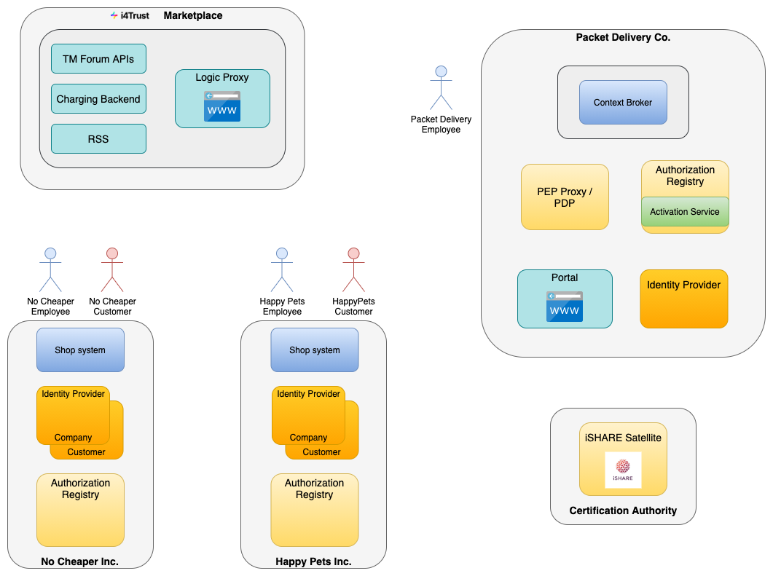
Overall Architecture

Slide 16
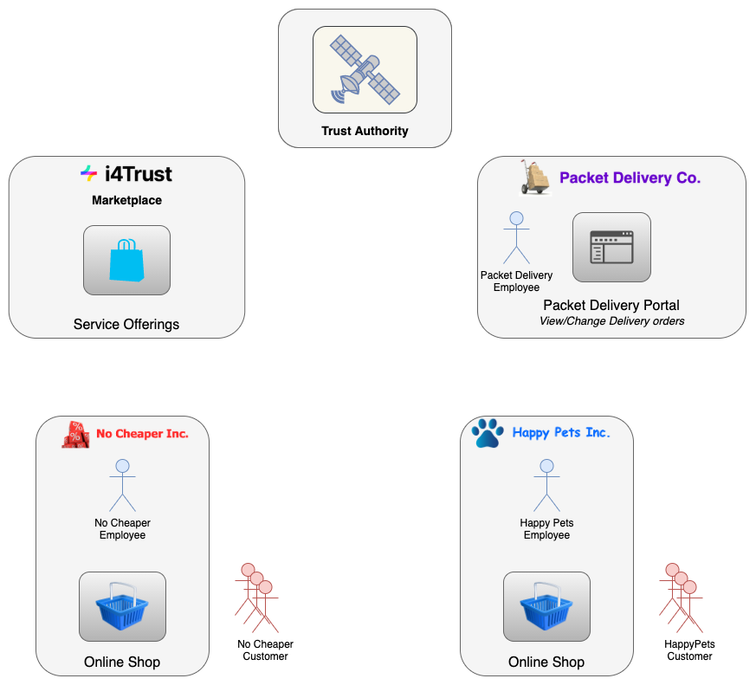
Example Overview
Showcase:
Delegation of data service access rights within trusted data space
Delegated from an organizational level to an user level
Service provider does not need knowledge about users which finally access the service
Parties:
Packet Delivery Co. offers delivery order service on i4Trust Marketplace
Different retailers (shops) acquire access to service offering
Retailers delegate service access to their customers
Trust Authority ensures trust among different organisations
Steps:
Creating an offering (by Packet Delivery Co.)
Acquiring an offering (by retailers)
Accessing packet delivery order service (by retailer customers)
Notes:
PoC Intro, showcase: delegation of data service access rights from organizational to user level, whole process divided into 3 steps

Slide 17
Demo of the reference example

Slide 18
Practical exercise
Come up with your own use case - it can be something you are already working on with SMEs or create one of your own
Alternatively, refer to the practical exercises presentation for some use cases
Try solving it similar to what was just explained using i4Trust and create an architecture and flow chart explaining the solution
Use open Q&A sessions and DIH Working Group Space to ask questions to us

Slide 19
<Name>
<Job Position>
<Company>
<email address>

